Slide 1
AJAX

Slide 2
What is AJAX?
AJAX = Asynchronous JavaScript and XML.
AJAX is a technique for creating fast and dynamic web pages.
AJAX allows web pages to be updated asynchronously by exchanging small amounts of data with the server behind the scenes -, and updating parts of a web page - without reloading the whole page.
Classic web pages must reload the entire page if the content should change.
Notes:
AJAX is not a new programming language, but a new way to use existing standards.
Google Suggest
AJAX was made popular in 2005 by Google, with Google Suggest.
Google Suggest is using AJAX to create a very dynamic web interface: When you start typing in Google's search box, a JavaScript sends the letters off to a server and the server returns a list of suggestions.

Slide 3
Examples of AJAX applications
Google Maps,
Gmail,
Youtube, and
Facebook tabs.

Slide 4
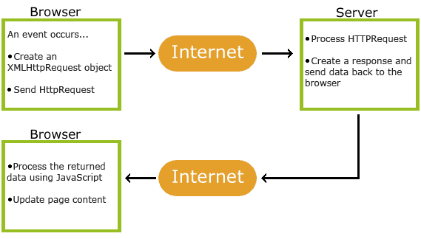
How AJAX Works

Slide 5
AJAX -Based on Internet Standards
AJAX is based on internet standards, and uses a combination of:
XMLHttpRequest object (to exchange data asynchronously with a server)
JavaScript/DOM (to display/interact with the information)
CSS (to style the data)
XML (often used as the format for transferring data)
AJAX applications are browser- and platform-independent!

Slide 6
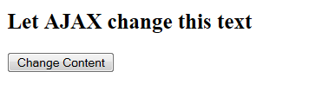
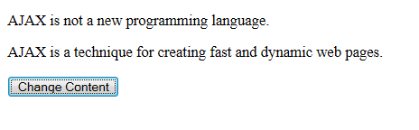
AJAX Example
example1

Slide 7
How AJAX works?
Create an XMLHttpRequest Object
Send a Request To a Server
Server Response
With AJAX, the JavaScript does not have to wait for the server response, but can instead:
execute other scripts while waiting for server response
deal with the response when the response ready

Slide 8
Step 1: Create an XMLHttpRequest Object
XMLHttpRequest object is used to exchange data with a server by updating parts of a web page, without reloading the whole page.
All modern browsers have a built-in XMLHttpRequest object
Syntax for creating an XMLHttpRequest object:
var xmlhttp;
if (window.XMLHttpRequest).
xmlhttp=new XMLHttpRequest();
else //IE5 and IE6 use an ActiveX Object:
xmlhttp=new ActiveXObject("Microsoft.XMLHTTP");
Notes:
All modern browsers (IE7+, Firefox, Chrome, Safari, and Opera) have a built-in XMLHttpRequest object
IE5 and IE6 use an ActiveXObject.

Slide 9
Step 2: Send a Request To a Server
To send a request to a server, use the open() and send() methods of the XMLHttpRequest object:
Method | Description
open(method, url, async) | Specifies the type of request, the URL, and if the request should be handled asynchronously or not. method: the type of request: GET or POST url: the location of the file on the server The file can be any kind of file, like .txt and .xml, or server scripting files like .asp and .php (which can perform actions on the server before sending the response back). async: true (asynchronous ) for the XMLHttpRequest object to behave as AJAX or false (synchronous)
send(string) | Sends the request off to the server. string: Only used for POST requests

Slide 10
Async=true
Step 2: Send a Request To a Server
When using async=true, specify a function to execute when the response is ready in the onreadystatechange event:
xmlhttp.onreadystatechange=function(){
if (xmlhttp.readyState==4 &&xmlhttp.status==200){
document.getElementById("myDiv").innerHTML=xmlhttp.responseText;
}
}
xmlhttp.open("GET","ajax_info.txt",true);
xmlhttp.send();
Notes:
ajax - onreadystatechange property
Before we even think about sending data to the server, we must first write a function that will be able to receive information. This function will be used to catch the data that is returned by the server.
The XMLHttpRequest object has a special property calledonreadystatechange. onreadystatechange stores the function that will process the response from the server.

Slide 11
Async=false
Step 2: Send a Request To a Server
To use async=false, change the third parameter in the open() method to false:
Using async=false is not recommended, but for a few small requests this can be ok.
Remember that the JavaScript will NOT continue to execute, until the server response is ready. If the server is busy or slow, the application will hang or stop.
Note:When you use async=false, do NOT write an onreadystatechange function - just put the code after the send() statement:
xmlhttp.open("GET","ajax_info.txt",false);

Slide 12
method :GET or POST?
Step 2: Send a Request To a Server
GET is simpler and faster than POST, and can be used in most cases.
However, always use POST requests when:
A cached file is not an option (update a file or database on the server)
Sending a large amount of data to the server (POST has no size limitations)
Sending user input (which can contain unknown characters), POST is more robust and secure than GET

Slide 13
GET Requests
Step 2: Send a Request To a Server
xmlhttp.open("GET","demo_get.php",true);
xmlhttp.send();
example2
If you want to send information with the GET method, add the information to the URL:
xmlhttp.open("GET","demo_get2.php?fname=Henry&lname=Ford",true); xmlhttp.send();
example2b

Slide 14
POST Requests
Step 2: Send a Request To a Server
To POST data like an HTML form, add an HTTP header with setRequestHeader(). Specify the data you want to send in the send() method:

Slide 15
POST Requests
Step 2: Send a Request To a Server
xmlhttp.open("POST","demo_post.php",true); xmlhttp.send();
example3
xmlhttp.open("POST","ajax_test.php",true); xmlhttp.setRequestHeader("Content-type",
"application/x-www-form-urlencoded"); xmlhttp.send("fname=Henry&lname=Ford");
example3b

Slide 16
XMLHttpRequest Properties
Step 2. Send a Request To a Server

Slide 17
The onreadystatechange event
Step 3. Server Response
When a request to a server is sent, we want to perform some actions based on the response.
The onreadystatechange event is triggered every time the readyState changes.
onreadystatechange stores the function that will process the response from the server.
The readyState property holds the status of the XMLHttpRequest.
Notes:
ajax - onreadystatechange property
Before we even think about sending data to the server, we must first write a function that will be able to receive information. This function will be used to catch the data that is returned by the server.
The XMLHttpRequest object has a special property calledonreadystatechange. onreadystatechange stores the function that will process the response from the server.
We will be filling this function in throughout the lesson, as you learn more about the XMLHttpRequest object.
Javascript Code:
// Create a function that will receive data sent from the server
ajaxRequest.onreadystatechange = function(){
// We still need to write some code here
}

Slide 18
The onreadystatechange event
Step 3. Server Response
When readyState is 4 (server's response is complete) and status is 200, the response is ready:
xmlhttp.onreadystatechange=function(){
// Get the data from the server's response if (xmlhttp.readyState==4 &&xmlhttp.status==200) { document.getElementById("myDiv").innerHTML
=xmlhttp.responseText; } }
Notes:
Javascript Code:
// Create a function that will receive data sent from the server
ajaxRequest.onreadystatechange = function(){
// We still need to write some code here
}
This property, onreadystatechange, stores a function. As the name sort of implies, every time the "ready state" changes this function will be executed. What is this "ready state" and is it any use to us?

Slide 19
Server Response
Step 3. Server Response
To get the response from a server, use the responseText or responseXML property of the XMLHttpRequest object.
Property | Description
responseText | get the response data as a string
responseXML | get the response data as XML data
document.getElementById("myDiv").innerHTML=xmlhttp.responseText;

Slide 20
The responseXML Property
Step 3. Server Response
If the response from the server is XML, and you want to parse it as an XML object, use the responseXML property:
Request the file cd_catalog.xml and parse the response:
xmlDoc=xmlhttp.responseXML;
txt="";
x=xmlDoc.getElementsByTagName("ARTIST");
for (i=0;i<x.length;i++) {
txt=txt + x[i].childNodes[0].nodeValue + "<br>";
}
document.getElementById("myDiv").innerHTML=txt;
example4

Slide 21
Using a Callback Function
A callback function is a function passed as a parameter to another function.
If you have more than one AJAX task on your website, you should create ONE standard function for creating the XMLHttpRequest object, and call this for each AJAX task.
The function call should contain the URL and what to do on onreadystatechange (which is probably different for each call):

Slide 22
Using a Callback Function
function myFunction(){
loadXMLDoc("ajax_info.txt",function() { if (xmlhttp.readyState==4 &&xmlhttp.status==200) {
document.getElementById("myDiv").innerHTML=xmlhttp.responseText;
} }); }
example5

Slide 23
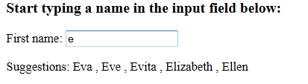
AJAX PHP Example
example6
When a user types a character in the input field above, the function "showHint()" is executed. The function is triggered by the "onkeyup" event:
The page on the server called by the JavaScript above is an PHP file called "gethint.php".
Refer to the gethint.php for the details

Slide 24
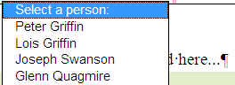
AJAX Database Example
AJAX can be used for interactive communication with a database.
example7

Slide 25
AJAX Database Example
id | FirstName | LastName | Age | Hometown | Job
1 | Peter | Griffin | 41 | Quahog | Brewery
2 | Lois | Griffin | 40 | Newport | Piano Teacher
3 | Joseph | Swanson | 39 | Quahog | Police Officer
4 | Glenn | Quagmire | 41 | Quahog | Pilot
When a user selects a user in the dropdown list above, a function called "showUser()" is executed. The function is triggered by the "onchange" event:
Refer to example7 for details
Notes:
The page on the server called by the JavaScript above is a PHP file called "getuser.php".
The source code in "getuser.php" runs a query against a MySQL database, and returns the result in an HTML table:
Explanation:
When the query is sent from the JavaScript to the PHP file, the following happens:
PHP opens a connection to a MySQL server
The correct person is found
An HTML table is created, filled with data, and sent back to the "txtHint" placeholder

Slide 26
AJAX XML Example
AJAX can be used for interactive communication with an XML file.
The following example will demonstrate how a web page can fetch information from an XML file with AJAX:
:Get CD info
example8
example8b

Slide 27
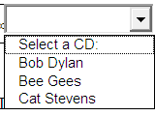
AJAX XML Example
The AJAX Server Page
The page on the server used in the example above, is an XML file called "cd_catalog.xml".
The example9 will demonstrate how a web page can fetch information from an XML file with AJAX:
CD info will be listed here...
Notes:
The HTML Page
When a user selects a CD in the dropdown list above, a function called "showCD()" is executed. The function is triggered by the "onchange" event.
The showCD() function does the following:
Check if a CD is selected
Create an XMLHttpRequest object
Create the function to be executed when the server response is ready
Send the request off to a file on the server
Notice that a parameter (q) is added to the URL (with the content of the dropdown list)
The page on the server called by the JavaScript above is a PHP file called "getcd.php".
The PHP script loads an XML document, "cd_catalog.xml", runs a query against the XML file, and returns the result as HTML.
When the CD query is sent from the JavaScript to the PHP page, the following happens:
PHP creates an XML DOM object
Find all <artist> elements that matches the name sent from the JavaScript
Output the album information (send to the "txtHint" placeholder)

Slide 28
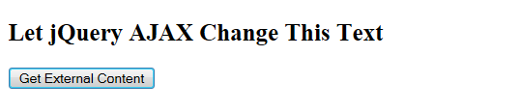
jQuery - AJAX
Example1

Slide 29
What About jQuery and AJAX?
jQuery provides several methods for AJAX functionality.
With the jQuery AJAX methods, you can request text, HTML, XML, or JSON from a remote server using both HTTP Get and HTTP Post - And you can load the external data directly into the selected HTML elements of your web page!
Notes:
Without jQuery, AJAX coding can be a bit tricky! Writing regular AJAX code can be a bit tricky, because different browsers have different syntax for AJAX implementation. This means that you will have to write extra code to test for different browsers. However, the jQuery team has taken care of this for us, so that we can write AJAX functionality with only one single line of code.

Slide 30
jQuery load() Method
is a simple, but powerful AJAX method.
loads data from a server and puts the returned data into the selected element.
Syntax:
The required URL parameter specifies the URL you wish to load.
The optional data parameter specifies a set of query string key/value pairs to send along with the request.
The optional callback parameter is the name of a function to be executed after the load() method is completed.
$(selector).load(URL,data,callback);

Slide 31
jQuery load() Method
Content of "demo_test.txt":
The following example loads the content of the file "demo_test.txt" into a specific <div> element:
<h2>jQuery and AJAX is FUN!!!</h2> <p id="p1">This is some text in a paragraph.</p>
$("#div1").load("demo_test.txt");
Example1

Slide 32
jQuery load() Method
It is also possible to add a jQuery selector to the URL parameter.
The following example loads the content of the element with id="p1", inside the file "demo_test.txt", into a specific <div> element:
$("#div1").load("demo_test.txt #p1");
example1b

Slide 33
jQuery load() Method
The following example displays an alert box after the load() method completes.
$("button").click(function(){ $("#div1").load("demo_test.txt",function(responseTxt,statusTxt,xhr){ if(statusTxt=="success") alert("External content loaded successfully!"); if(statusTxt=="error") alert("Error: "+xhr.status+": "+xhr.statusText); }); });
example1c
Notes:
If the load() method has succeed, it displays "External content loaded successfully!", and if it fails it displays an error message:

Slide 34
jQuery load() Method
The optional callback parameter specifies a callback function to run when the load() method is completed. The callback function can have different parameters:
responseTxt - contains the resulting content if the call succeed
statusTXT - contains the status of the call
xhr - contains the XMLHttpRequest object
jQuery AJAX Reference: http://www.w3schools.com/jquery/jquery_ref_ajax.asp

Slide 35
jQuery $.get() Method
The $.get() method requests data from the server with an HTTP GET request.
Syntax:
The required URL parameter specifies the URL you wish to request.
The optional callback parameter is the name of a function to be executed if the request succeeds.
The following example uses the $.get() method to retrieve data from a file on the server:
$.get(URL,callback);

Slide 36
jQuery $.get() Method
$("button").click(function(){ $.get("demo_test.php",function(data,status){ alert("Data: " + data + "\nStatus: " + status); }); });
The first parameter of $.get() is the URL we wish to request ("demo_test.php").
The second parameter is a callback function. The first callback parameter holds the content of the page requested, and the second callback parameter holds the status of the request.
example2

Slide 37
jQuery $.post() Method
The $.post() method requests data from the server using an HTTP POST request.
Syntax:
The required URL parameter specifies the URL you wish to request.
The optional data parameter specifies some data to send along with the request.
The optional callback parameter is the name of a function to be executed if the request succeeds.
$.post(URL,data,callback);

Slide 38
jQuery $.post() Method
$("button").click(function(){ $.post("demo_test_post.php", { name:"Donald Duck", city:"Duckburg" }, function(data,status){ alert("Data: " + data + "\nStatus: " + status); }); });
example2b

Slide 39
jQuery $.post() Method
The first parameter of $.post() is the URL we wish to request ("demo_test_post.php").
Then we pass in some data to send along with the request (name and city).
The PHP script in "demo_test_post.php" reads the parameters, process them, and return a result.
The third parameter is a callback function. The first callback parameter holds the content of the page requested, and the second callback parameter holds the status of the request.

Slide 40
The End

